Slide 1
Deleting Elements in an Array | Array Operations
Deleting elements when position is given
Deleting elements when value is
given ( sorted/ unsorted array)

Slide 2
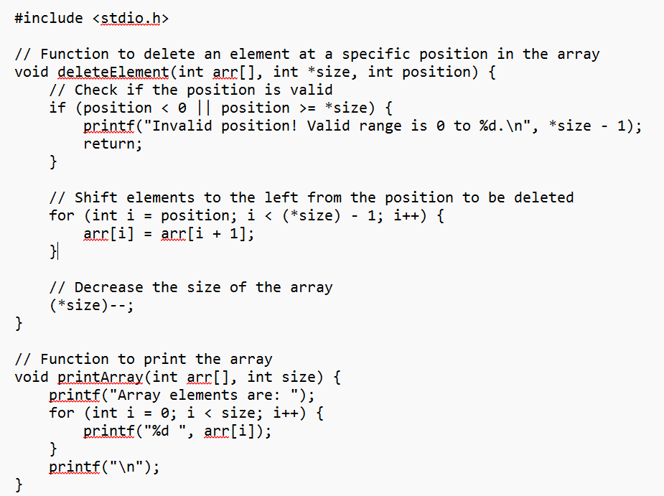

Slide 3
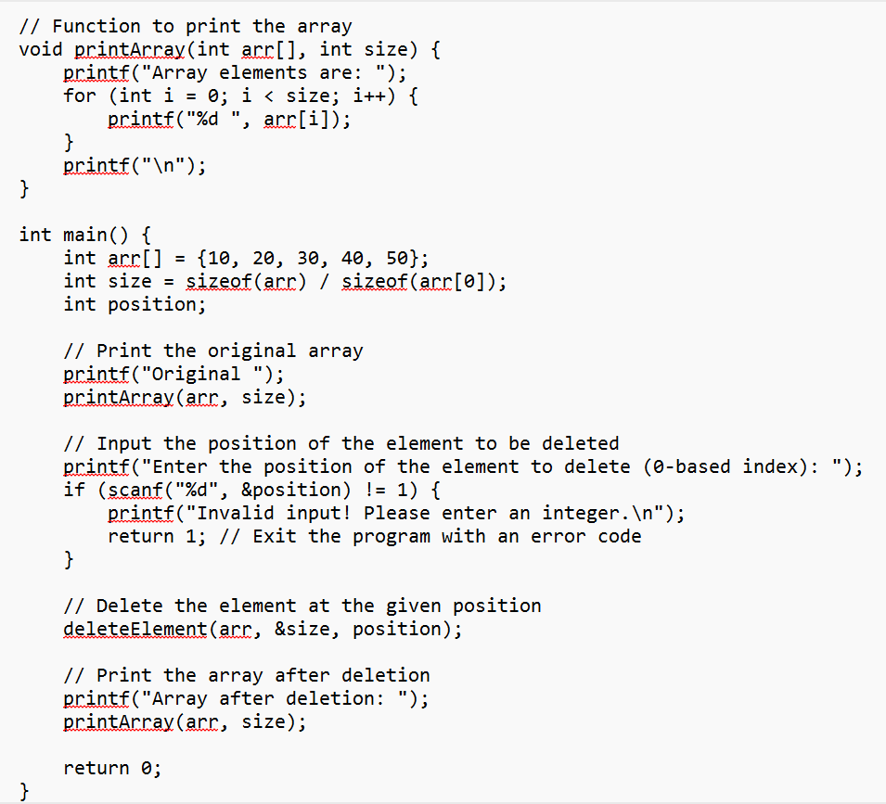

Slide 4
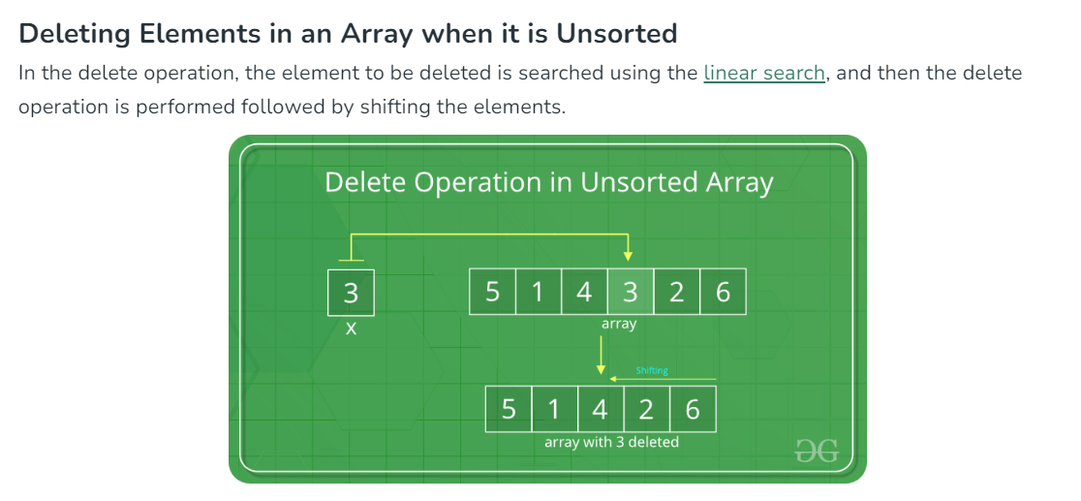

Slide 5
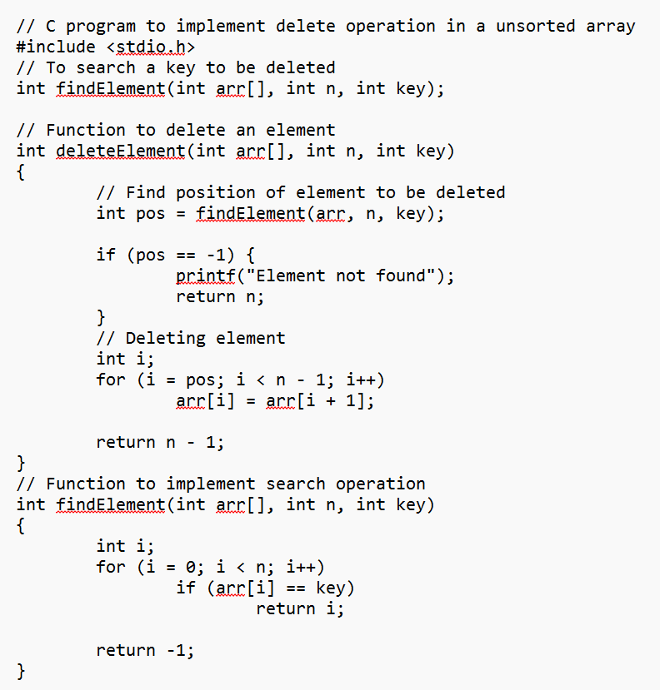
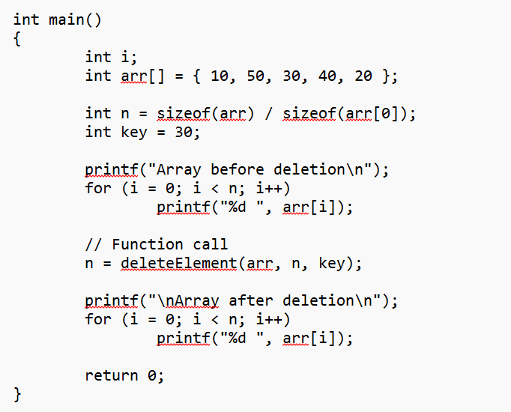

Slide 6
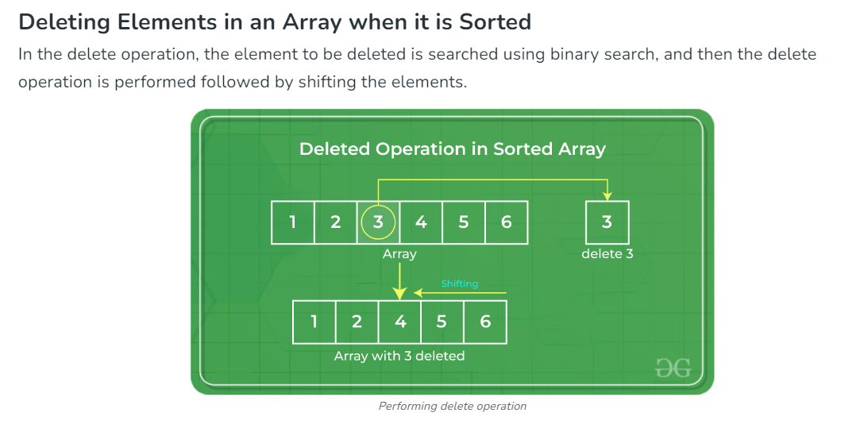

Slide 7
